Slide 1

End-to-End Demand Forecasting + Inventory Optimization System
A comprehensive SQL + Python solution for multi-store retail networks using Walmart's 45-store dataset

Slide 2

The Retail Inventory Challenge
Walmart operates 45 retail stores across multiple regions, each facing unique demand patterns driven by temperature fluctuations, fuel prices, holiday seasons, and macroeconomic indicators.
Managing inventory efficiently across this complex network is critical to business success.
Stockouts
Overstock
Demand Spikes
Lost sales opportunities when demand exceeds supply
Excessive holding costs from inventory surplus
Unpredictable surges during holiday periods

Slide 3

Business Problem & Solution Goals
Core Challenges
System Objectives
Inaccurate demand forecasts
12-Week Forecasts
Predict future demand per store with precision
High stockout probabilities
Safety Stock Calculation
Excessive inventory holding
Determine optimal buffer inventory and reorder points
Poorly timed procurement
Risk Identification
Flag understock and overstock scenarios
Lack of store-wise visibility
Order Optimization
Recommend quantities that minimize costs
Cost Savings
Highlight opportunities to reduce inefficiencies

Slide 4
Dataset Overview
Walmart Retail Sales Dataset
6.4K
45
Source: Kaggle Walmart Dataset
A comprehensive time-series dataset containing 6,435 rows across 45 stores with 8 features including weekly sales, holiday flags, temperature, fuel prices, CPI, and unemployment rates.
Total Records
Store Locations
8
Key Features
Key Variables
Store ID
Date
Unique identifier for each location
Week-wise timestamp
Weekly Sales
Holiday Flag
Revenue per week
Binary indicator
Temperature
Fuel Price
Weather data
Gas cost trends

Slide 5
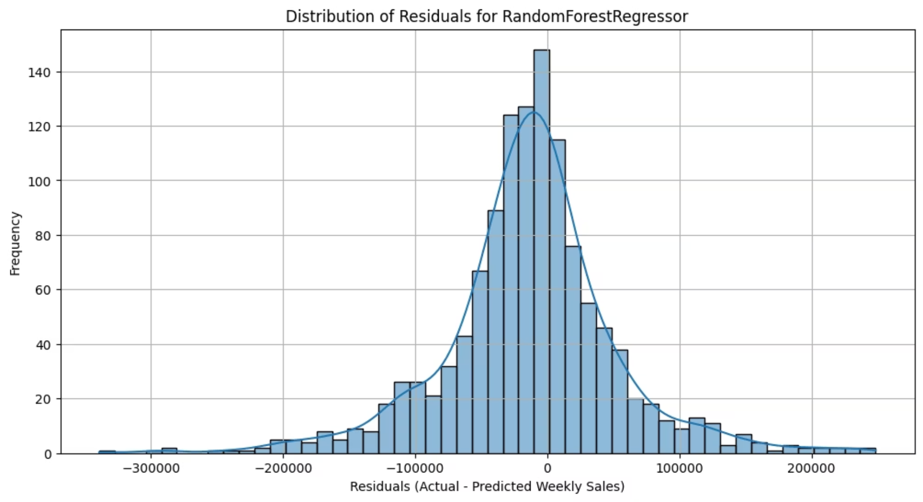
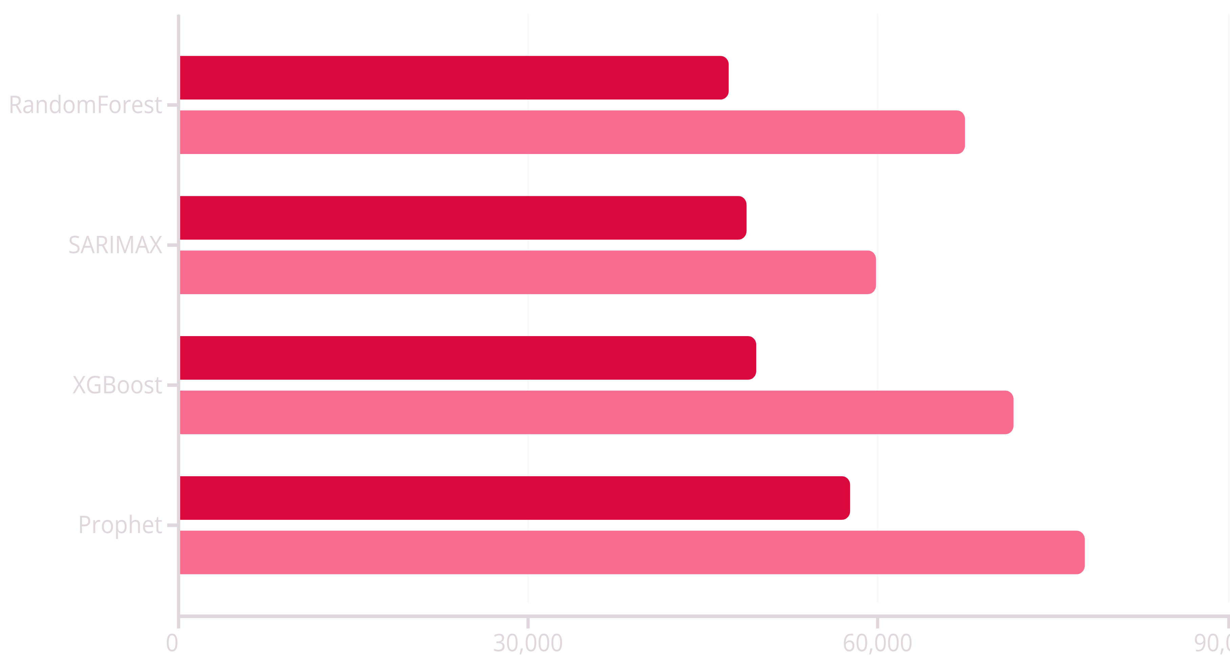
Methodology & Model Selection
01
02
Data Preparation
Exploratory Analysis
Parsed dates, sorted by store and time, removed duplicates, handled missing values, and resampled weekly data
Identified holiday impact, fuel/CPI correlations, store-level volatility, and clear weekly seasonality patterns
03
04
Model Testing
Inventory Framework
Evaluated SARIMAX, RandomForest, XGBoost, Prophet, and Naive baseline models
Calculated safety stock, demand during lead time, and reorder points
Model Performance Comparison
MAE
RMSE
Winner: SARIMAX selected for lowest RMSE (59,828), superior seasonality handling, and stable residual patterns

Slide 6



Inventory Optimization Framework
The system calculates critical inventory metrics using industry-standard formulas to ensure 95% service level while minimizing holding costs.
95%
Service Level
Target reliability
1.65
Z-Score
Confidence factor
Safety Stock
Demand During Lead Time
Reorder Point (ROP)
Formula: Z × σdemand × √(lead_time)
Formula: mean_demand × lead_time
Formula: (mean_demand × lead_time) + safety_stock
Buffer inventory to protect against demand variability and supply uncertainty
Expected consumption between order placement and delivery
Trigger level that signals when to replenish inventory

Slide 7
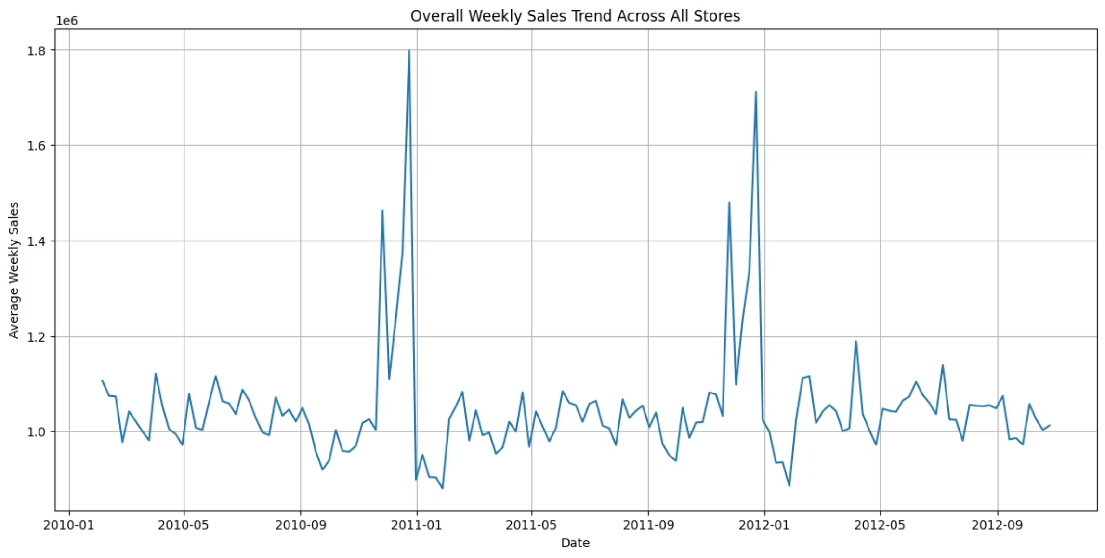
Critical Findings: System-Wide Understock
100% of stores are understocked
Analysis reveals that all 45 stores have current inventory levels below their calculated reorder points, creating immediate stockout risk and requiring urgent replenishment action.
Highest-Risk Stores Requiring Immediate Action
Store 4
Recommended Order: 23.65M units
Safety Stock: 619,231 | ROP: 5,014,420
Store 2
Recommended Order: 21.19M units
Safety Stock: 552,894 | ROP: 4,478,250
Store 20
Recommended Order: High priority replenishment needed
Store 31
Recommended Order: Critical deficit identified
Largest Order Requirement
Peak Demand Analysis
Store 33 requires minimal replenishment at just 3.09M units, indicating lower demand volatility
12-week forecasts show weekly sales ranging from $1.046M to $1.081M with slight increases during December-January period

Slide 8



Strategic Recommendations
Priority Ordering
ROP-Based Automation
Safety Stock Adjustment
Focus immediate replenishment on Stores 4, 2, 20, 31, and 13 which show the highest inventory deficits
Implement automatic ordering triggers when stock approaches calculated reorder point levels
Increase buffers for high-variance stores to maintain minimum 95% service level
Smooth Replenishment
Holiday Monitoring
Lead Time Optimization
Align weekly procurement cycles to calculated ROPs for predictable inventory flow
Adjust forecasts upward during holiday weeks due to proven demand spikes
Reducing lead time significantly lowers safety stock and ROP requirements, driving major cost savings
Expected Benefits
Prevent Stockouts
Reduce Rush Orders
Eliminate lost sales opportunities through proactive inventory management
Lower costly last-minute expedited shipping expenses
Optimize Operations
Lower Holding Costs
Enable better labor scheduling and warehouse space planning
Avoid excessive inventory while maintaining service levels

Slide 9
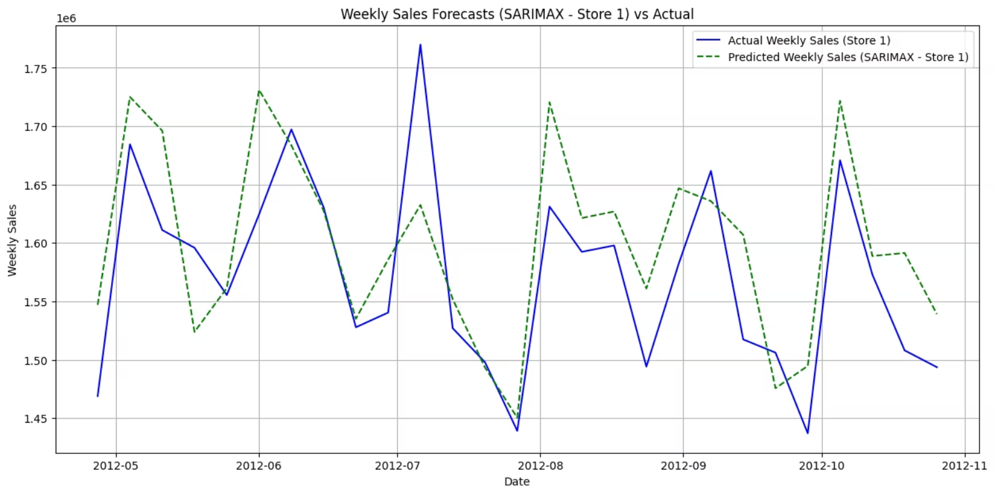
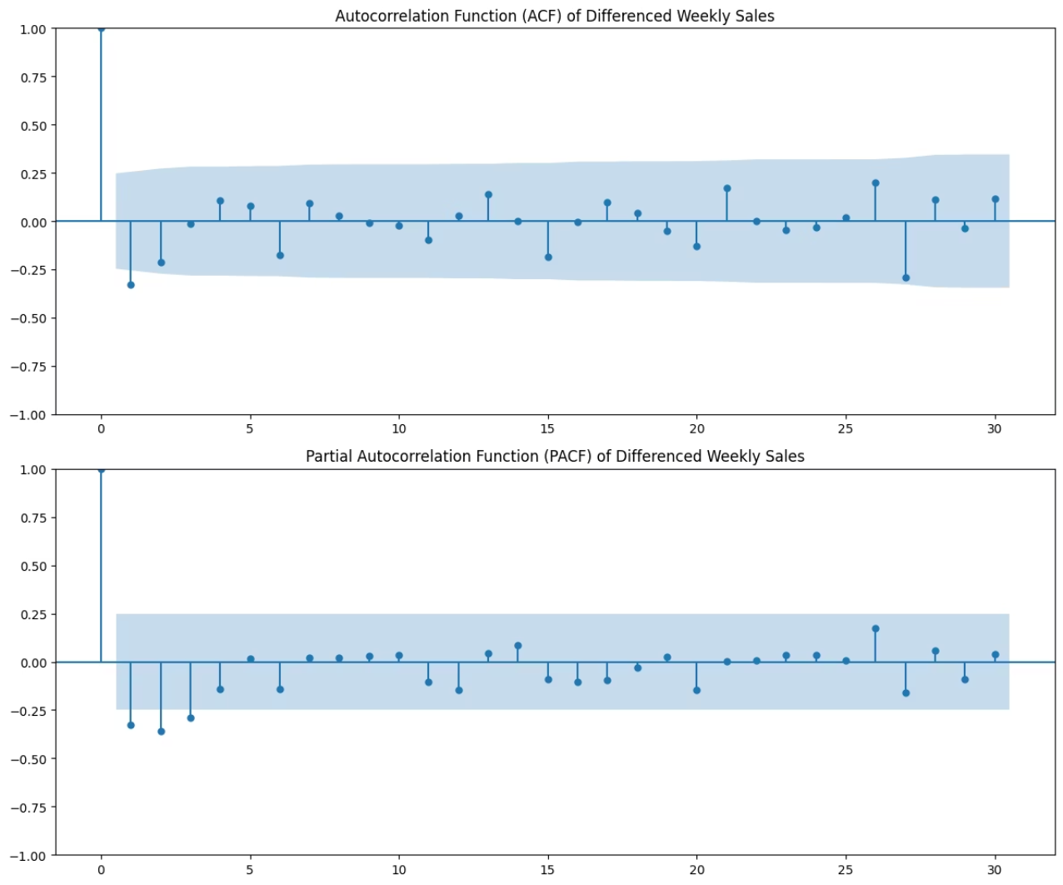
Conclusion & Business Impact
This project successfully delivers a complete forecasting and inventory optimization system for Walmart's 45-store retail network using SQL and Python, demonstrating strong analytical and supply chain domain expertise.
Key Achievements
Best-in-Class Model
SARIMAX selected with RMSE of 59.8k, outperforming RandomForest, XGBoost, and Prophet
Complete Store Coverage
Generated precise 12-week demand forecasts for all 45 store locations
Comprehensive Metrics
Calculated safety stock and reorder points tailored to each store's demand patterns
Actionable Intelligence
Identified system-wide understock condition and provided store-specific replenishment quantities
Substantial Cost Savings
Enabled measurable reductions in stockout risks and overstock inefficiencies
This solution demonstrates enterprise-grade analytical capabilities in forecasting, inventory optimization, and supply chain management — ideal for senior Data/Supply Chain Analyst positions.

